Slide 1
Section I: Overview of the brand’s sales performance
Total sales = 101301
Total Revenue = 6699550.5
HOW
1- Remove duplicates
2- Creating a new column to sum the number of items bought in each order
3-Using pivot table to get the sum → we now have the Total sales
4- For Total Revenue: we set each blank entry to 0
5- Created a pivot table to get the Sum → we now have the Total Revenue

Slide 2
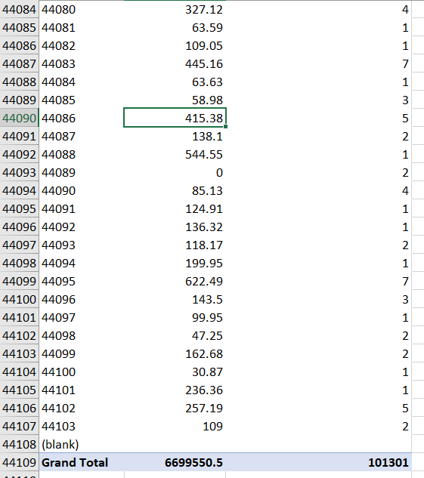
This is the excel formula I used to create a new column containing the sum of items bought in each order
This Pivot Table confirms the results of Total sales and total revenue mentioned in the previous slide

Slide 3
Revenue vs Attributes:
During this study, I have noticed that the revenue is significantly affected by numerous factors such as: the time of ordering, the geographical location and the gender of the customer

Slide 4
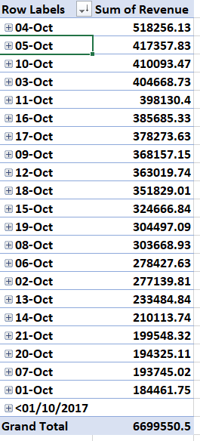
Revenue vs Time:
This pivot table shows us that the highest revenues were generated on the 4th, 5th and 10th of October while the least revenue was generated on 1st and the 7th of October
WHY???
You will find the answer on the next slide ;)

Slide 5
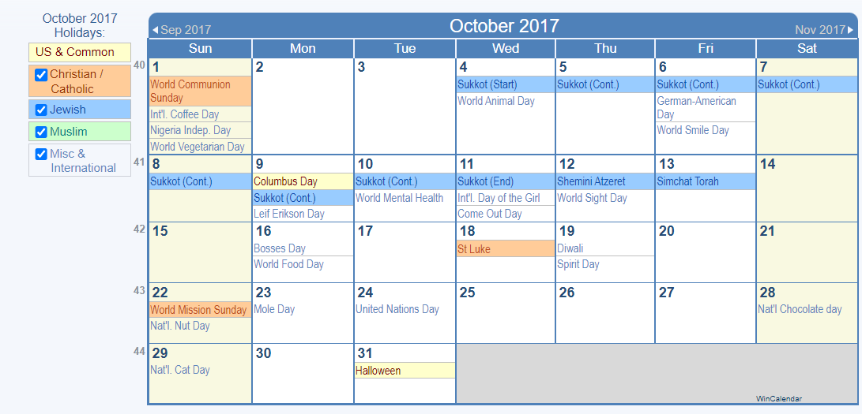
Since the year for this data set was given “2017”, I brought the calendar to illustrate more
The reasons why the 4th, 5th and 10th of October made the highest revenue is the fact that they all fall on holidays and especially the sukkot for Jewish people in the week days. While 1st and the 7th of October generated the last revenue because they fall in the weekend’s time frame which is Sunday and Saturday respectively. It is also worth mentioning that Jewish people prefer to take their whole day off from doing anything on Sunday which is presented in their culture.

Slide 6
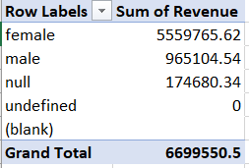
Gender vs Revenue
This pivot table shows that the highest revenue is generated by female customers which is significantly more than that of males. Around 83% of the revenue is generated by females orders

Slide 7
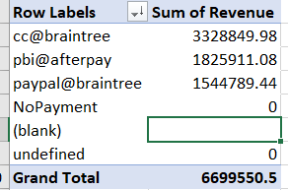
Payment Type vs Revenue
It is visible to us that cc@Braintree was the most payment method to generate revenue whereas paypal@braintree was the least one

Slide 8
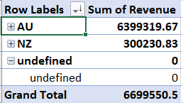
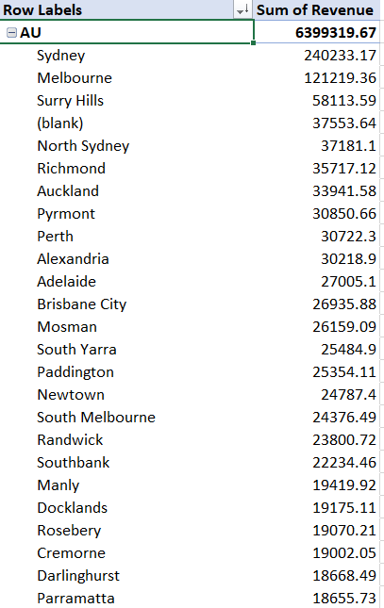
Geographical Location vs Revenue
We can see that African Uninion AU generated the company most of its revenue also under that we can see that the most two cities who took the lead role in this are: Sydney and Melbourne

Slide 9
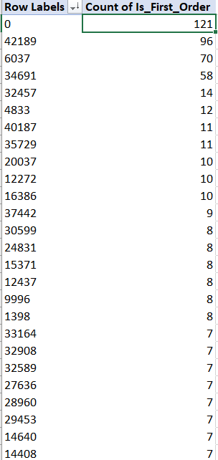
Single vs Multiple purchasers
We can see that userid 0,42189,6037 and 34691 had the highest first order

Slide 10
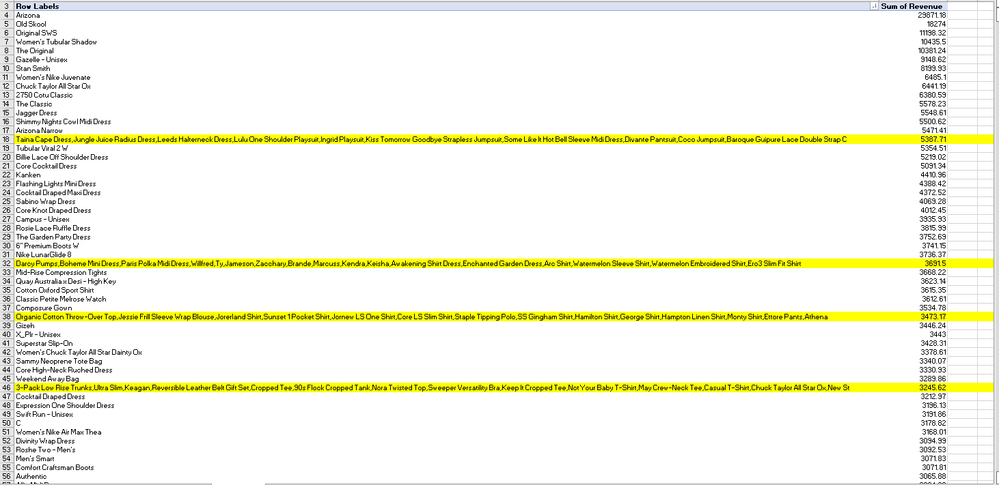
Items selling together
These are the most items that generate high revenue when sold together in the same order

Slide 11
Analysis, Insights and Recommendations
1- I could not tell whether this company is a successful company because I was not given the total costs nor the profit
2- Revenue is affected significantly by time. Since the company generates greatest amount of revenue in weekdays where there is a holiday and specifically a Jewish holiday, the company should follow a market segmentation based on the authenticity and religion of customers where they might offer special products that could be used during these holidays, offer promotions, discounts etc. Furthermore, since the company had minimal revenue on the weekends I believe that they must start adding some special events or discounts to encourage more sales.
3- Females took the most significant part in generating revenues. I suggest segmenting the market according to gender as well. For example, creating offers for males and females so that they would be more encouraged to buy. It would also be needed to do a market research to know why males do not buy much from the company. Identifying the problem is also necessary it could be the types of products, the website interface itself or what. I also noticed that the data set only contained males or females which is wrong and not inclusive. Numerous customers have different ways to identify their gender. Seeing only the M/F option would make the company lose many customers.
4- Revenue was also affected by payment type. I suggest the company to include points systems so that each time customers make payments, they will gain points that could be gathered to buy products or gain discounts. Furthermore, the company needs to do a research and know why people do not prefer to use paypal@Braintree because the revenue generated by paying using this method recorded the lowest compared to the other methods. Perhaps this payment method is not accessible in all the participated countries. Also, it could be true that some customers do not trust this payment method. Hence, I suggest adding other payment methods to be more inclusive and make sure that customers are comfortable while paying.
5- It was clearly seen that the geographical location plays a huge rule in the revenue generation process. For instance some places recorded most of the revenue while others barely recorded any. Hence, a new segmentation should be made according to the geographical location. To elaborate more, a market research should be conducted to know which items are mostly bought in each geographical location so that the company could target these areas using these specific products. Also, the company should verify whether the shipment process is functional well in these regions. They should increase their retailers and connections in these cities. If the company is not financially comfortable, they could just focus on targeting the places who generate the highest revenue to reduce costs and increase profit.

Slide 12
6- We have seen that some customers are loyal customers who purchase frequently using the single vs multiple purchasers pivot table. Again, I suggest adding a policy that gives loyal customers some discounts or promotions in order to encourage other customers to buy more than just once.
7- Numerous products were seen to excel in selling together as seen in the items selling together pivot table. Therefore, the company should follow selling some products in packages together like buy 1 get this for free. This technique would guarantee more sales and especially if this promotion type is based on products that are highly demanded together. Whereas the company should stop selling products that generates low revenues or try to combine them with other products in packages to check if the sales would increase.

